Slide 1
SOLID and Mvc
Presented by Thomas Bilodeau

Slide 2
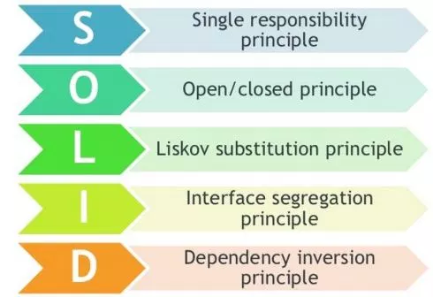
what we will cover
SOLID
Single-responsibility Principle
Open-closed Principle
Liskov Substitution Principle
Interface Segregation Principle
Dependency Inversion Principle
Honorary mention of DRY
MVC
Definition
MVC in OptDef

Slide 3
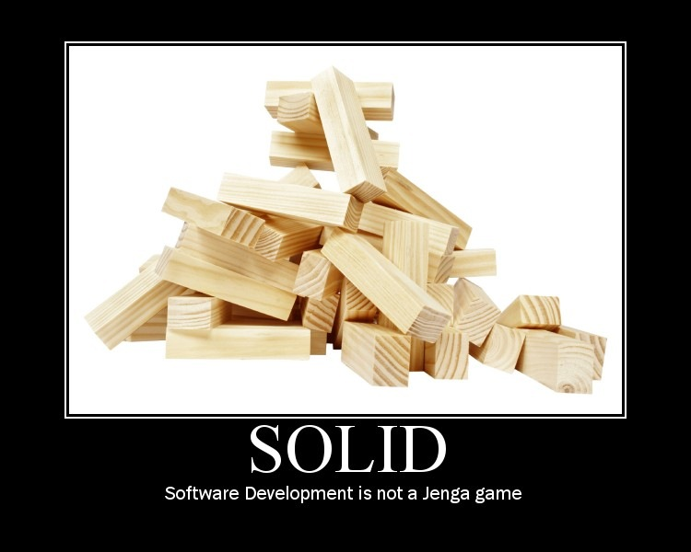
What is solid
Uncle Bob (Robert C. Martin)
First five OOD principles
NFJS, UberConf
We all write code we will cringe at

Slide 4
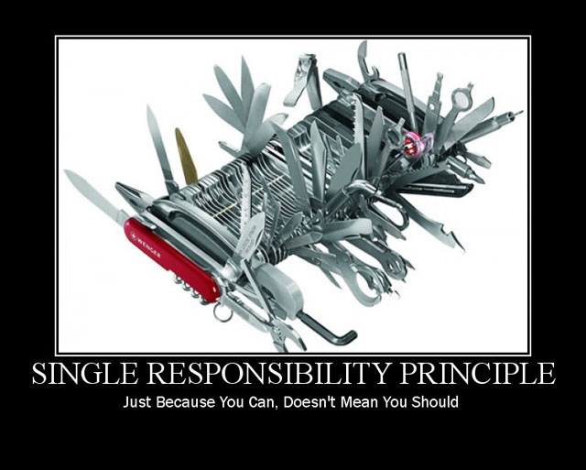
Single-responsibility principle
“A class should have one and only one reason to change, meaning that a class should have only one job.”

Slide 5
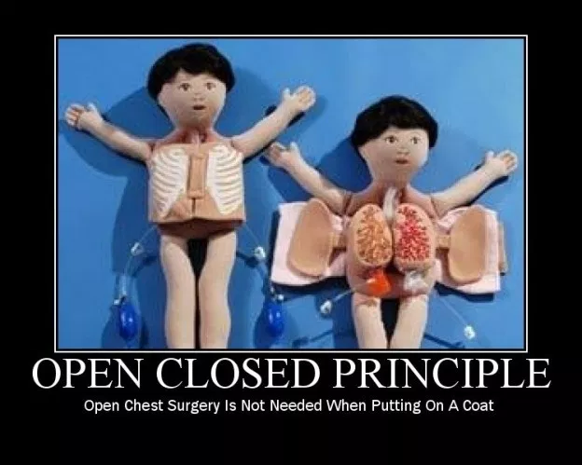
Open-closed principle
“Objects or entities should be open for extension, but closed for modification.”

Slide 6
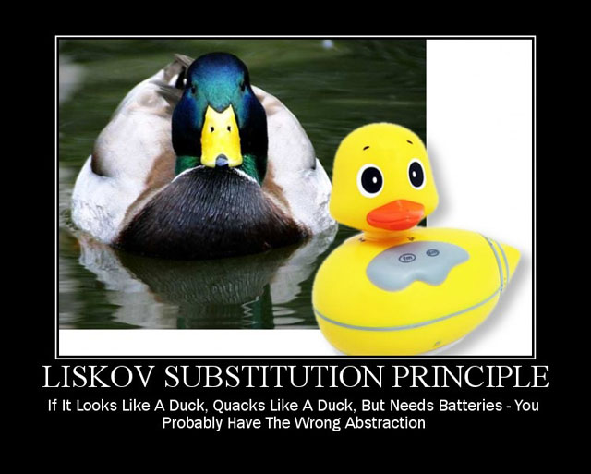
Liskov substitution principle
“Let q(x) be a property provable about objects of x of type T. Then q(y) should be provable for objects y of type S where S is a subtype of T.”
https://en.wikipedia.org/wiki/Circle-ellipse_problem
https://dzone.com/articles/the-liskov-substitution-principle-with-examples

Slide 7

Interface segregation principle
“A client should never be forced to implement an interface that it doesn’t use or clients shouldn’t be forced to depend on methods they do not use.”

Slide 8

Dependency inversion principle
“Entities must depend on abstractions not on concretions. It states that the high level module must not depend on the low level module, but they should depend on abstractions.”
https://dzone.com/articles/solid-principles-dependency-inversion-principle

Slide 9

Honorary shoutout to “DRY”
Do Not Repeat Yourself
Check OptTek Utilities
Check the project utilities package
(show Eclipse package navigation)
See something duplicated? Ask if it’s necessary.
OptDefIntegration is a weirdo

Slide 10
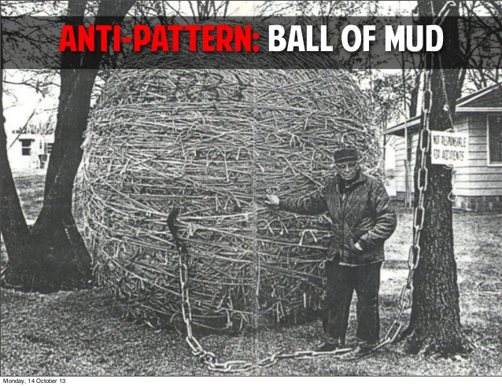
MVC Architecture
Model, View, Controller
Why?
Testing
Separation of Concerns
Variants:
MVP (Presenter)
MVVM (ViewModel)
PMVC (Presentation)
http://aalmiray.github.io/griffon-patterns/

Slide 11

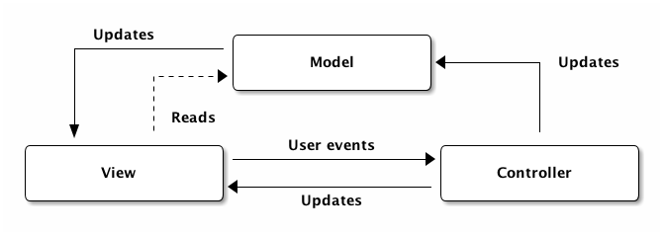
MVC Architecture Visualized

Slide 12
Mvc and optdef
Examples!
FilterView changes
MainWindow reliance
GUI objects never modify CoreModel or resultSet
Piecewise implementation
Not the end all be all
Drawing a line when doing refactoring

Slide 13
Helpful Links
https://scotch.io/bar-talk/s-o-l-i-d-the-first-five-principles-of-object-oriented-design
http://aalmiray.github.io/griffon-patterns/

